Slide 1
Lecture 11: Support Vector Machines

Slide 2
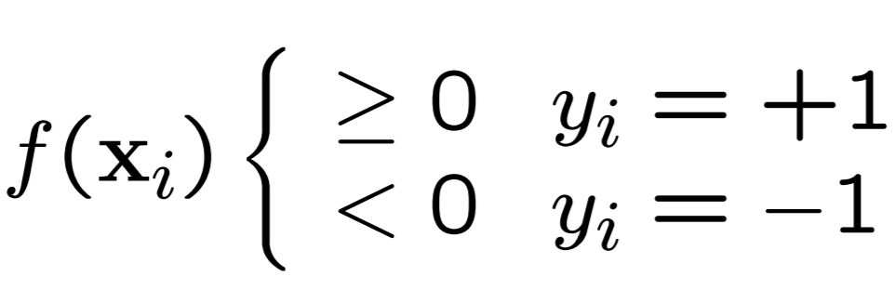
Binary classification
Given training data (x_{i}, y_{i}) for i = 1, 2, …, N where each y_{i} is -1 or +1
You want to learn a classifier f(x) such that:
Math is largely subjective, but this has the advantage of:
y_{i}*f(x_{i}) > 0 for a correct classification

Slide 3
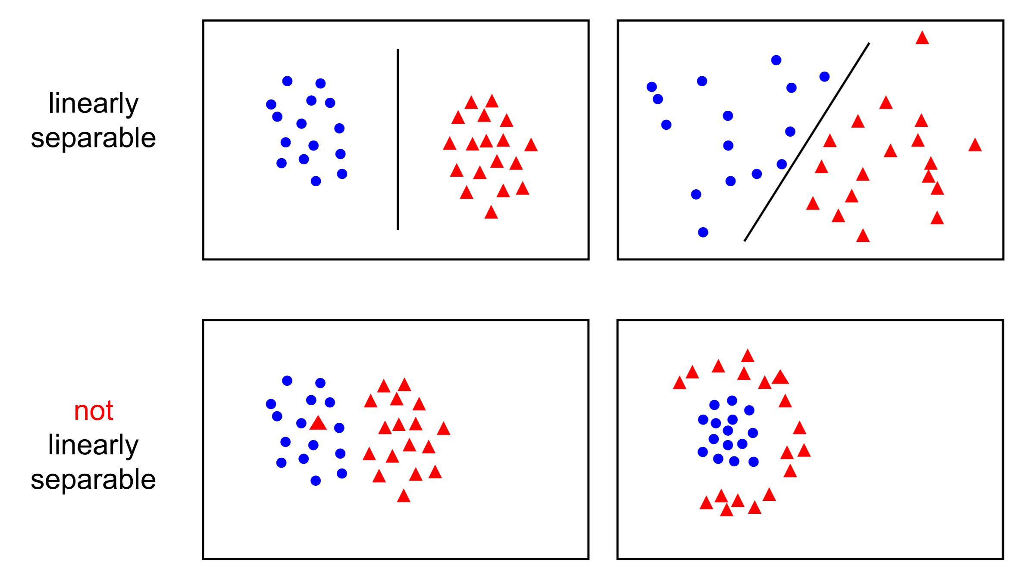
Linear separability

Slide 4
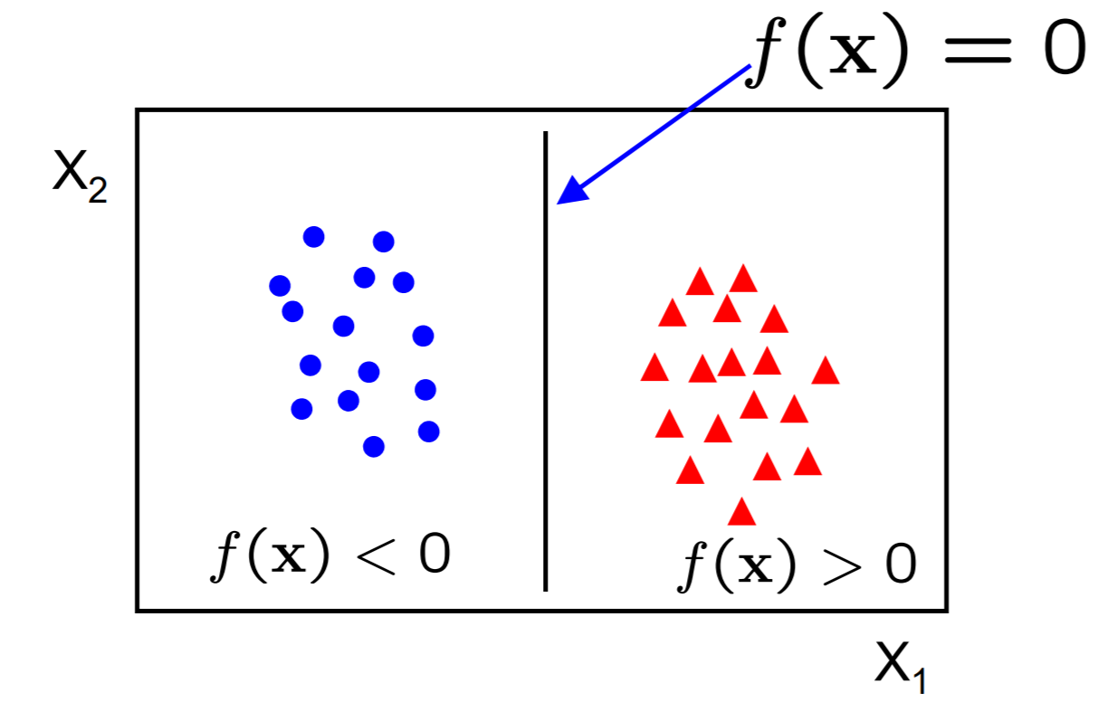
Linear classifiers
A linear classifier has the form f(x) = w^{T}x + b
In 2D, discriminant is a line
w is the normal to the line, b is the bias
w is known as the weight vector

Slide 5
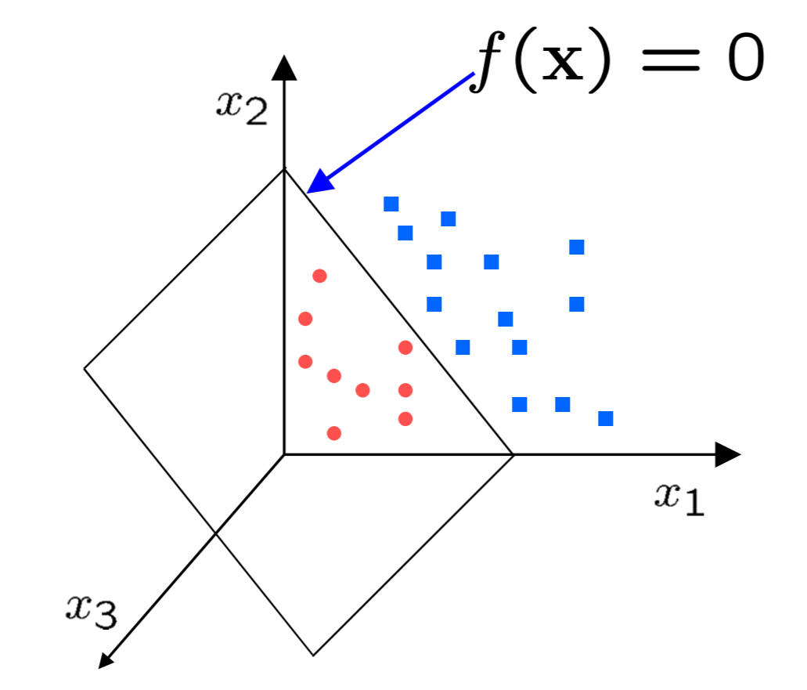
Linear classifiers
A linear classifier has the form f(x) = w^{T}x + b
In 3D, discriminant is a plane
For a linear classifier, the training data is used
to learn w and then discarded
Only w is needed for classifying new data

Slide 6
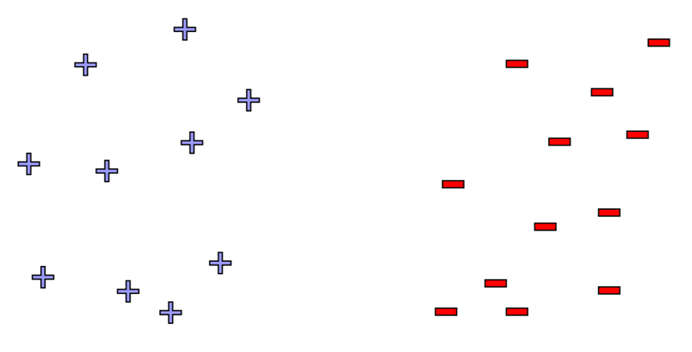
Reminder: perception algorithm
Perception is guaranteed to converge as long as the data is linearly separable

Slide 7
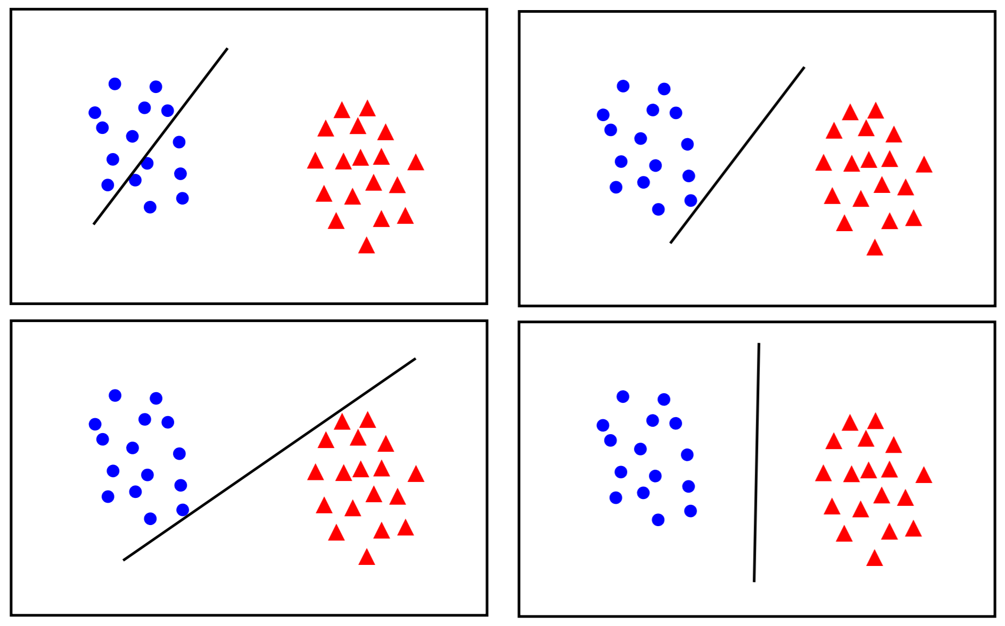
Perception algorithm – where to draw the line?

Slide 8
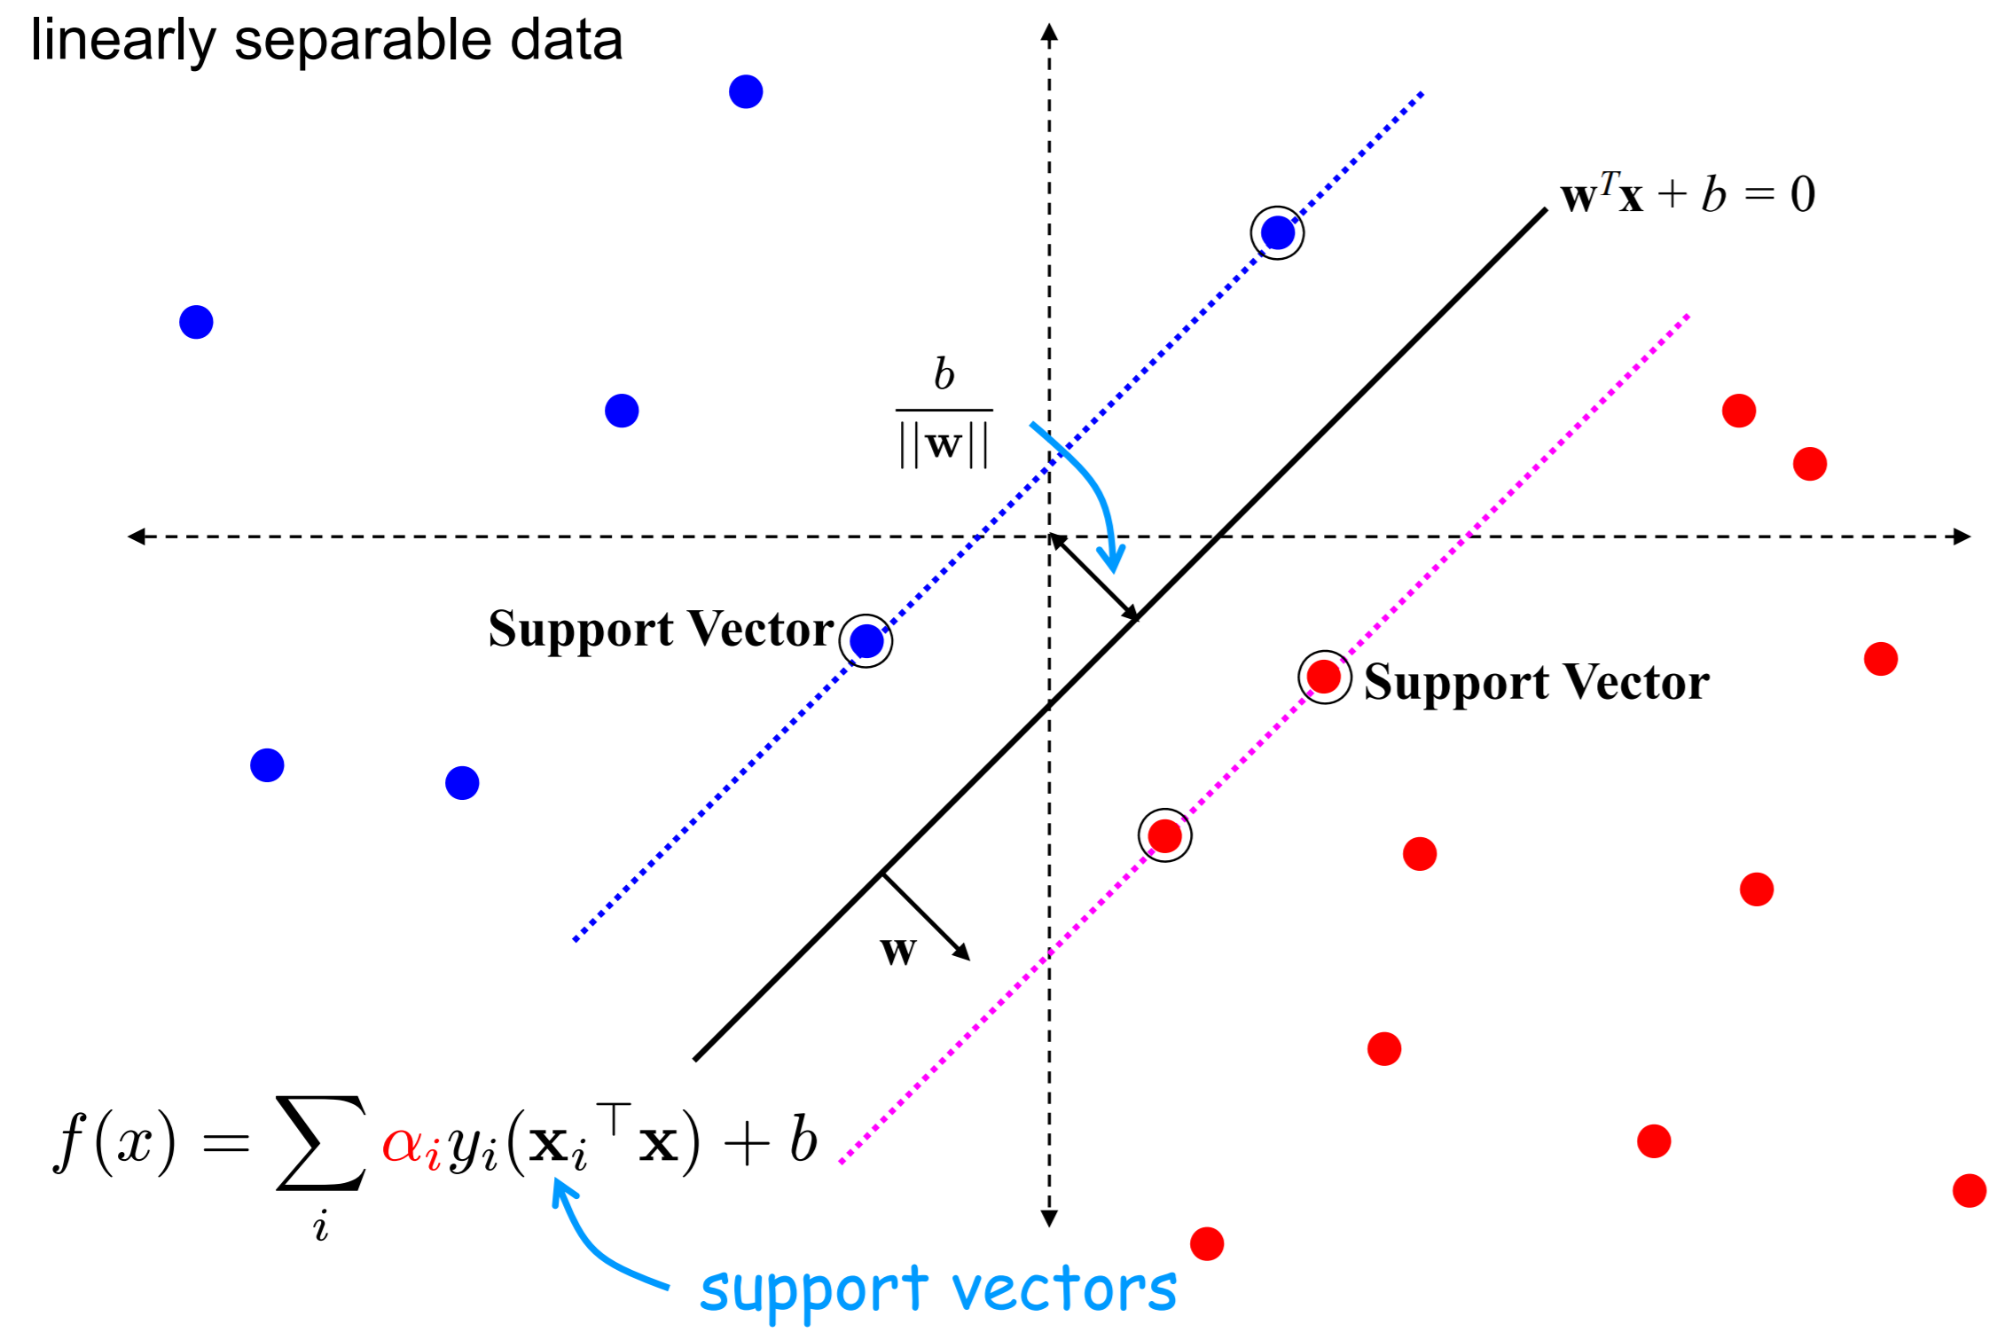
Support Vector Machine (SVM)

Slide 9
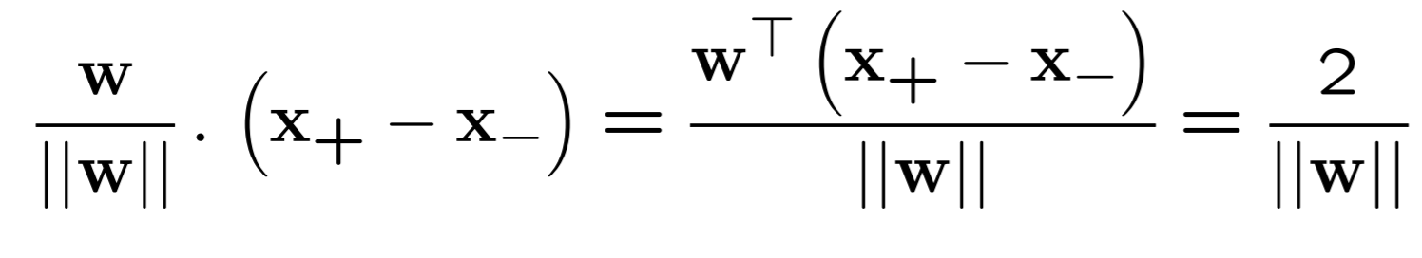
SVM
Since w^{T}x + b = 0 and c(w^{T}x + b) = 0 define the same plane, we have the freedom to choose the normalization of w
Choose normalization such that w^{T}x + b = +1 and w^{T}x + b = −1 for the positive and negative support vectors respectively
Then the margin is given by:

Slide 10
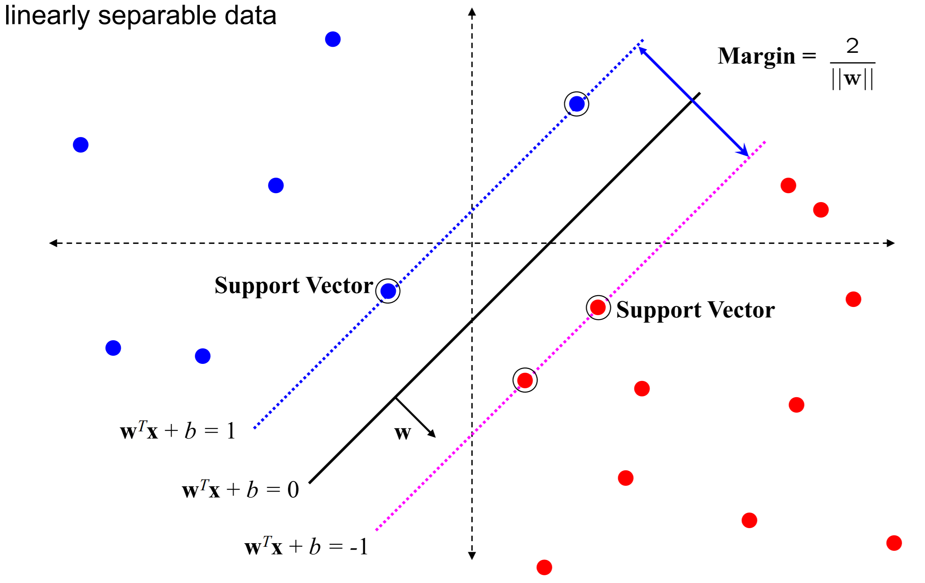
SVM

Slide 11
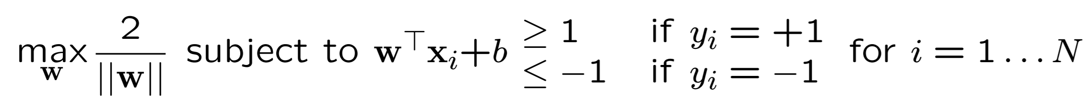
SVM -- optimization
Learning the SVM can be formulated as an optimization:
Or equivalently:
This is a quadratic optimization problem subject to linear constraints and there is a unique minimum

Slide 12
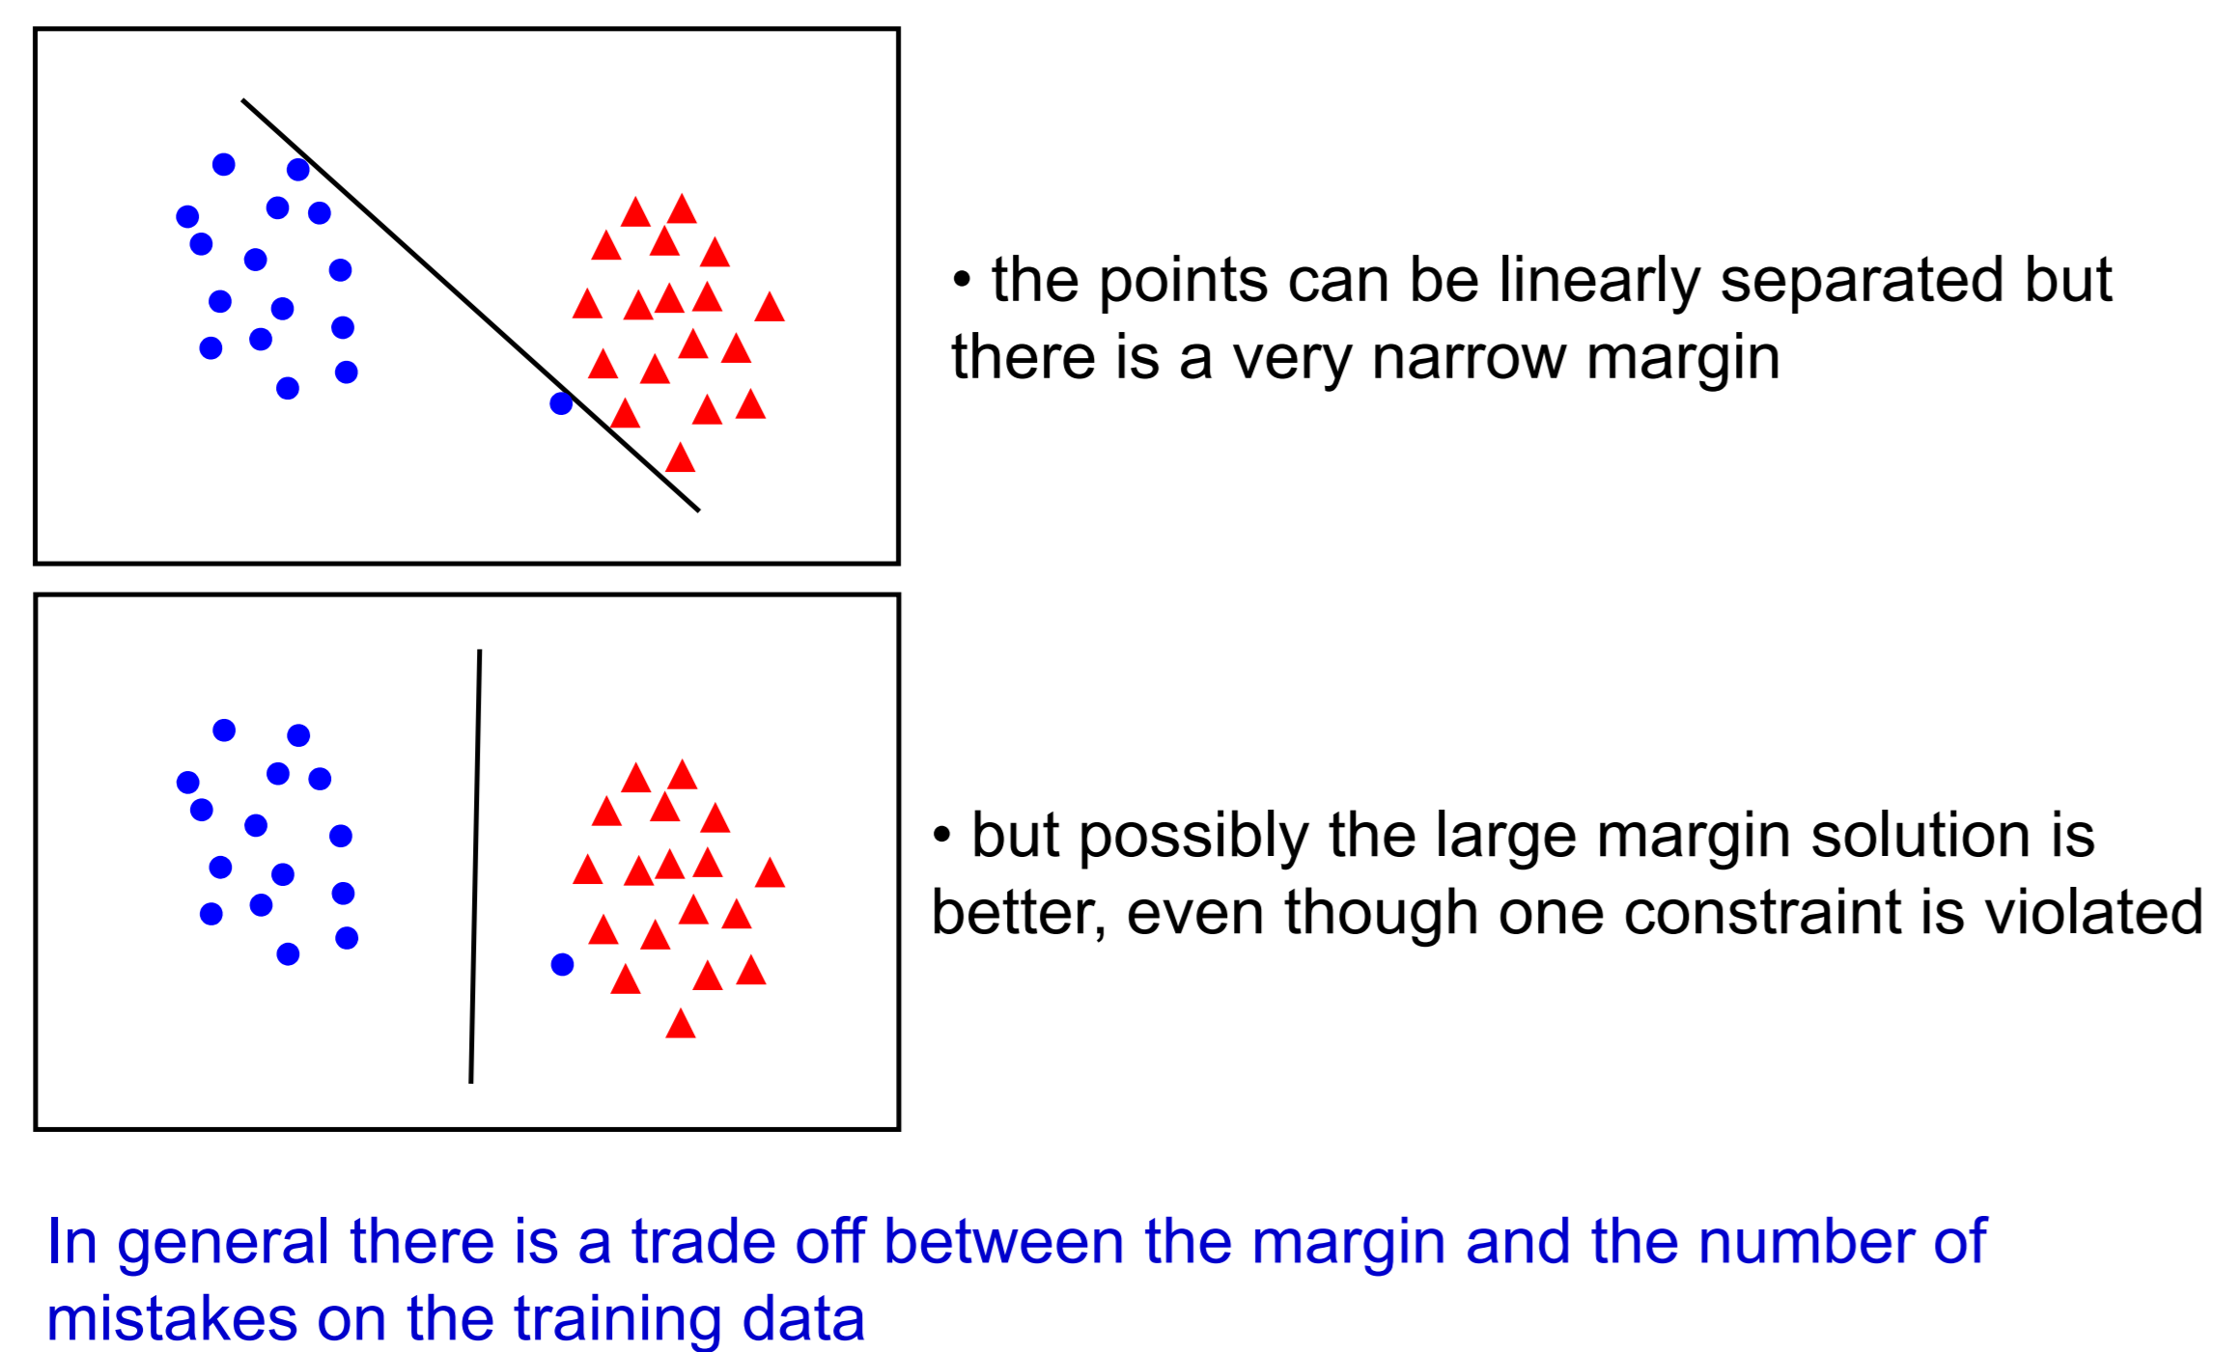
Selecting the best w

Slide 13
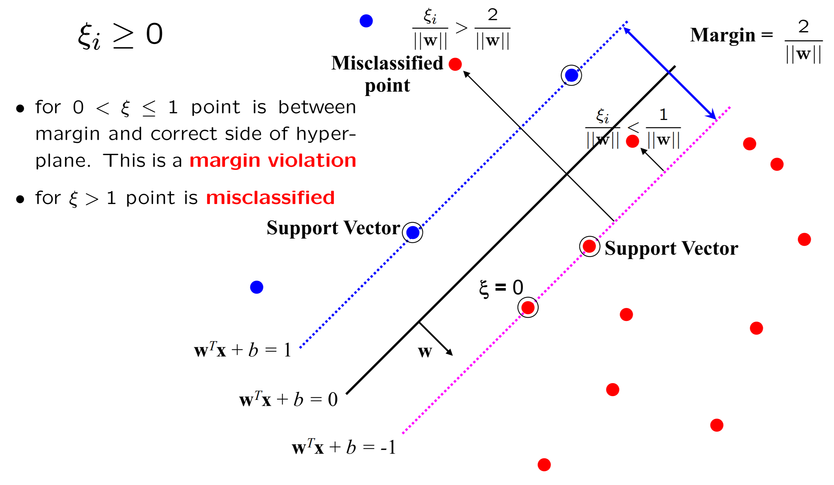
“Slack” variables

Slide 14
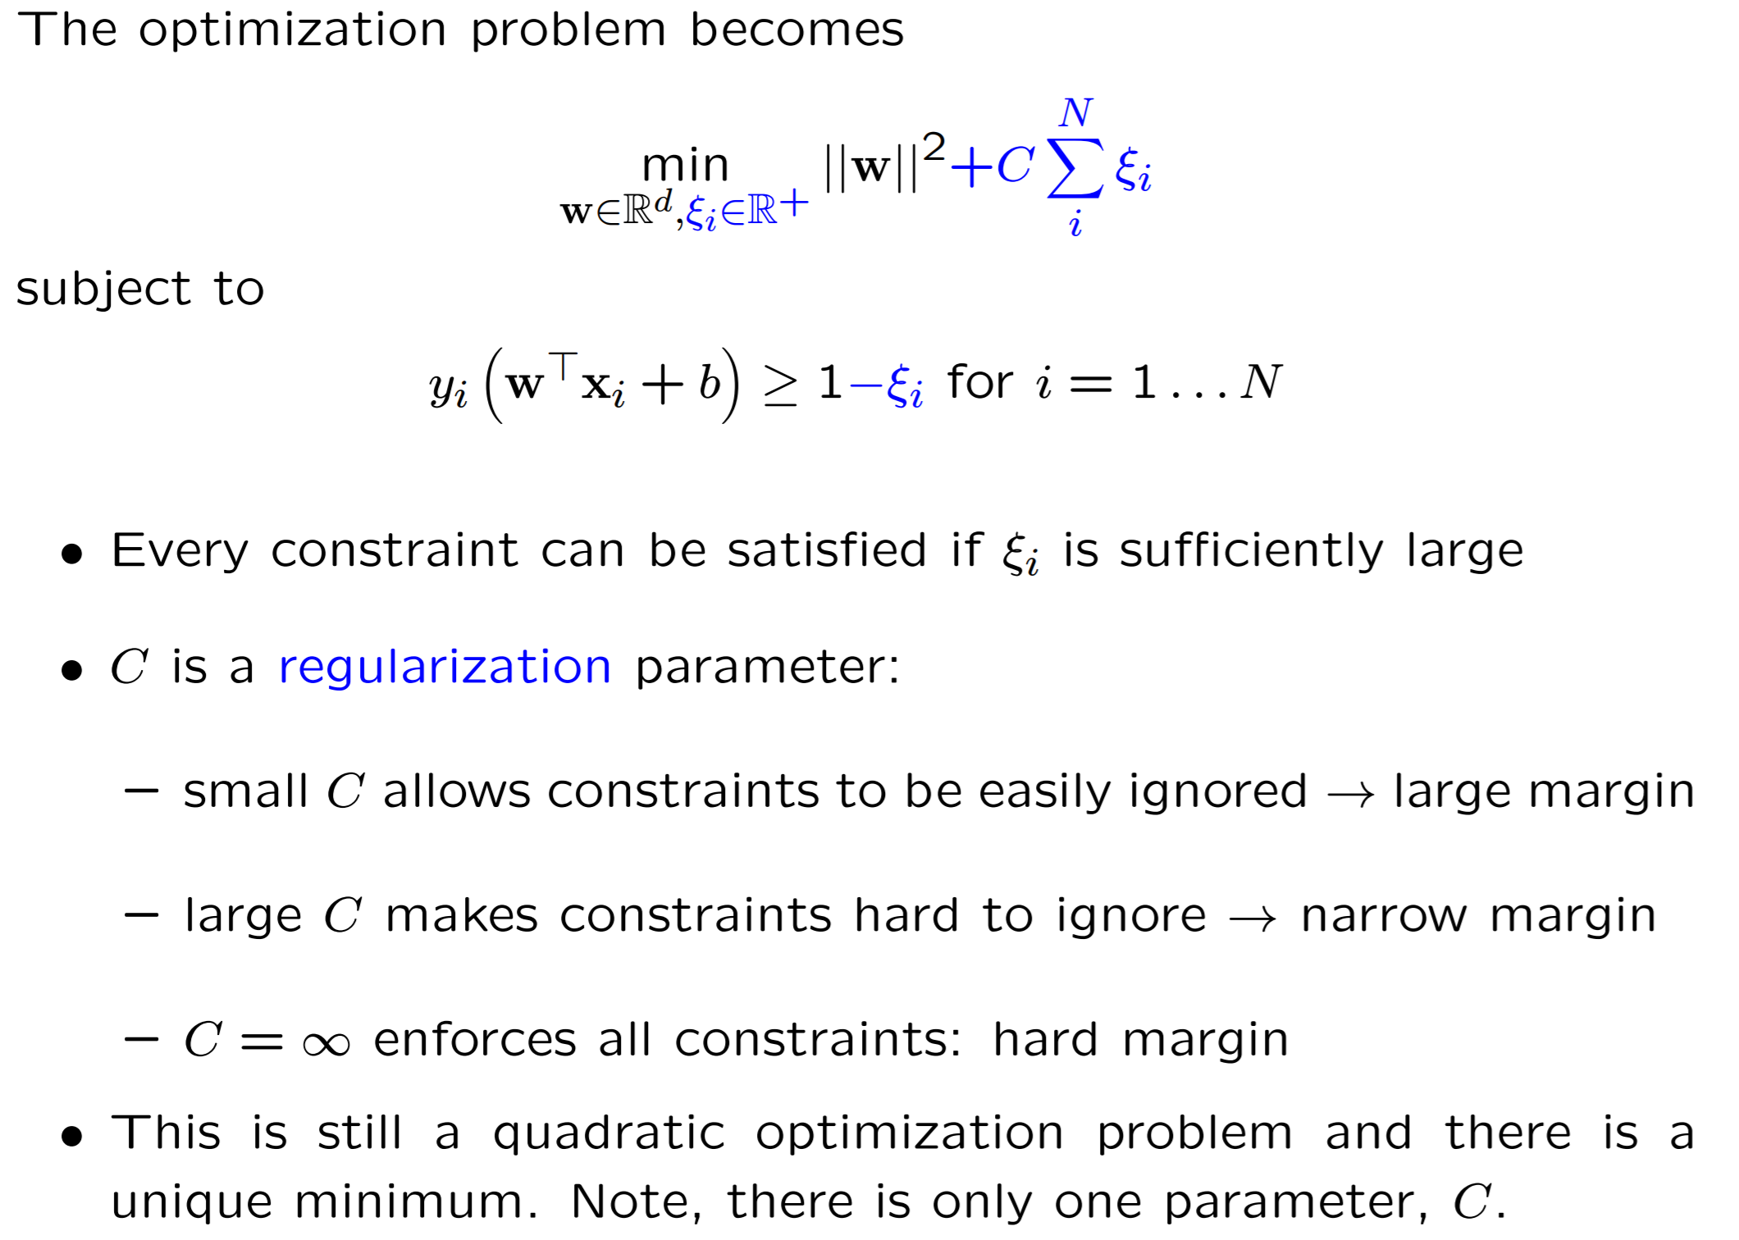
“Soft” margin solution

Slide 15
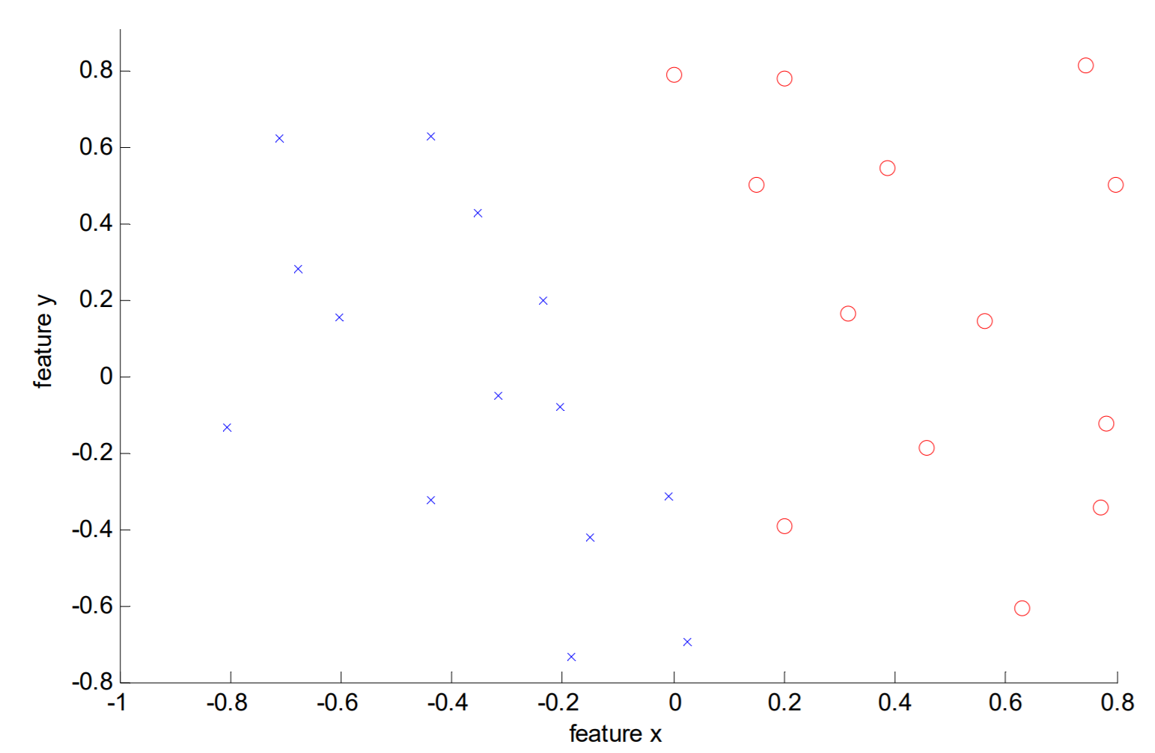
SVM
Data is linearly separable, but only in a narrow margin

Slide 16
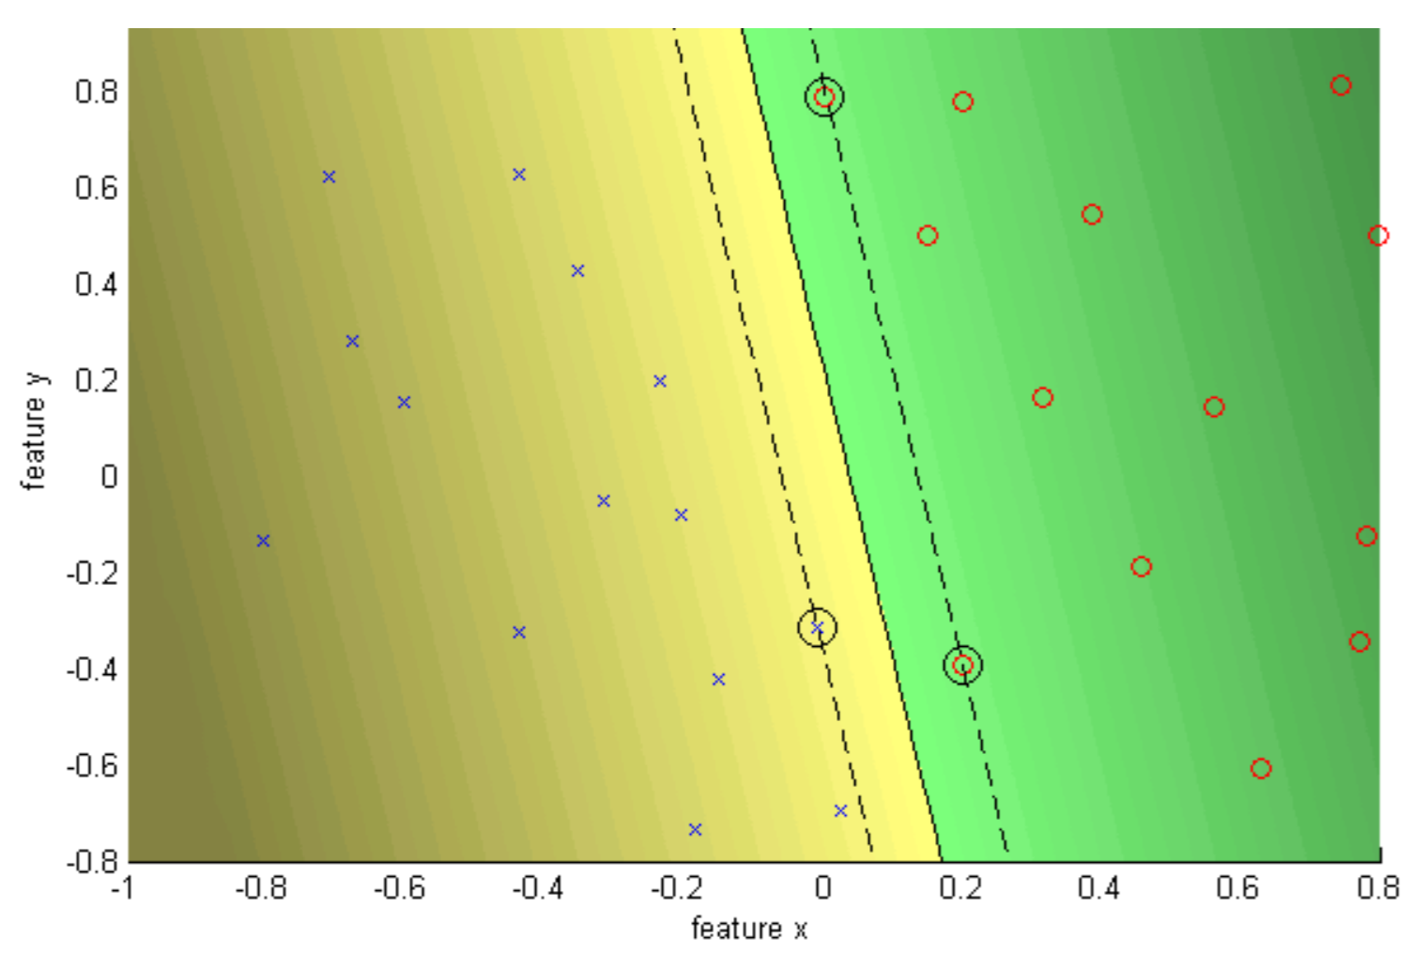
SVM – C = infinity
Hard margin

Slide 17
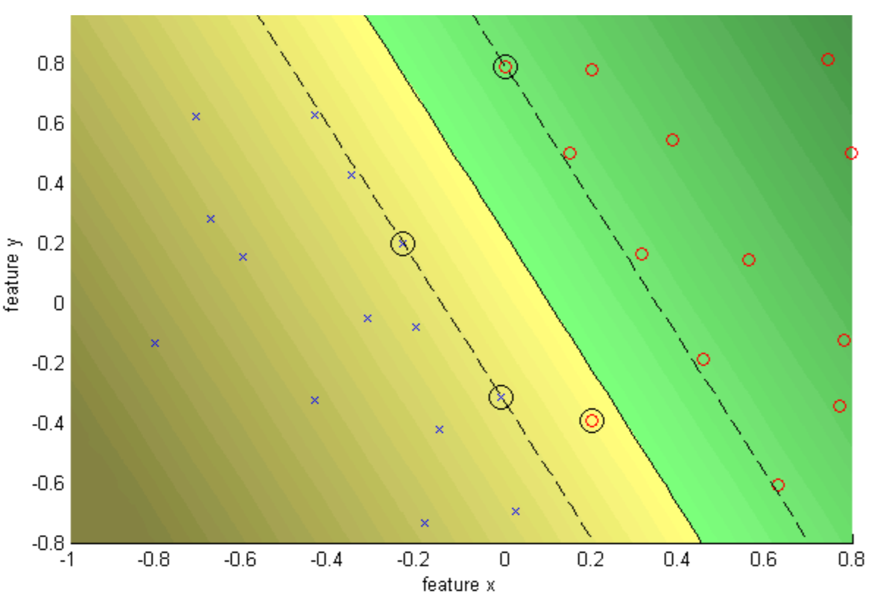
SVM – C = 10
Soft margin

Slide 18
Soft vs hard margin
Also sometimes called “soft constraint” and “hard constraint”
Refers to whether or not all of the training data is “correctly” classified by the classifier
  If all “dots” sort as they should, it’s a hard constraint
  If there are “dots” in the inappropriate region, it’s a soft constraint
  The presence of “slack” makes a soft margin

Slide 19
Application: pedestrian detection in computer vision
Objective: detect (localize) standing humans in an image (face detection with a sliding window classifier)
  Reduces object detection to binary classification
  Does an image window contain a person or not?

Slide 20
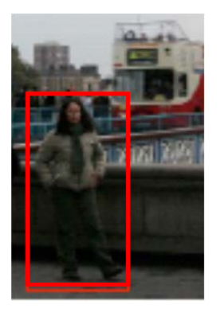
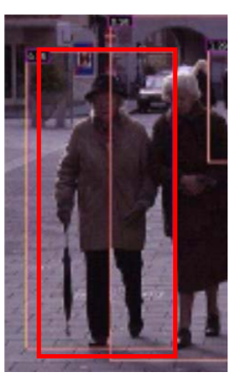
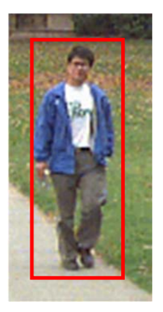
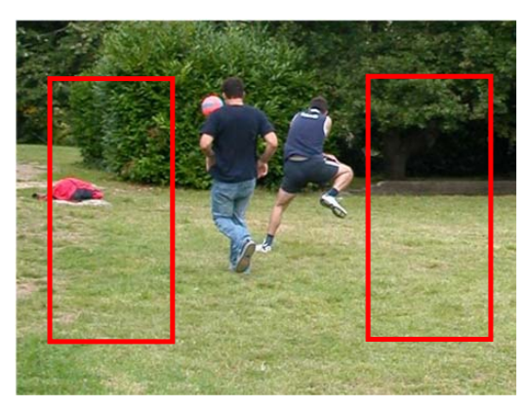
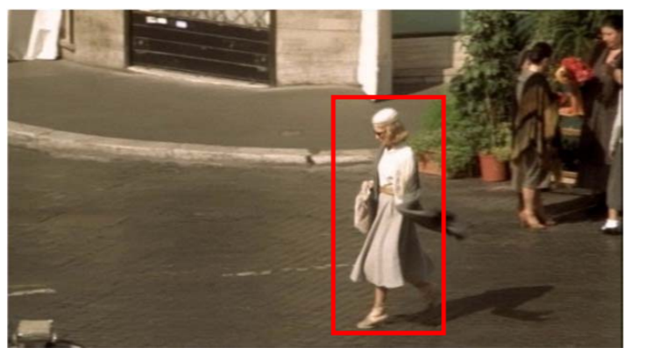
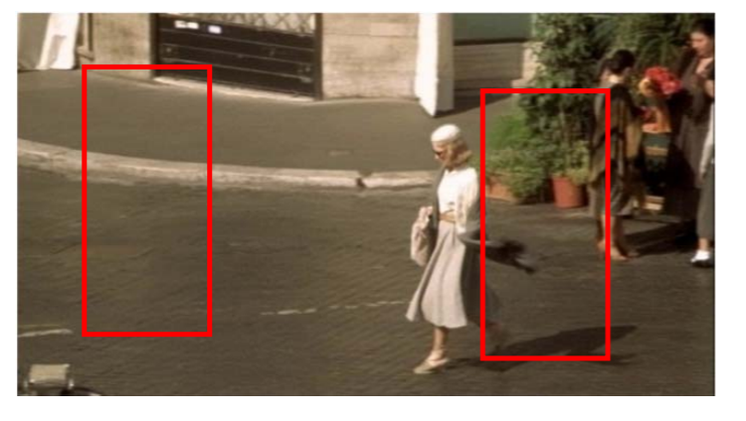
Training data and features
Positive data:
Negative data:

Slide 21
SVM “big picture”
We want to maximize the margin over the training data – that is the line should be maximally far away from the most number of data points
This means that you essentially want to minimize w
  This optimum w is often termed w*

Slide 22
SVM “big picture”
Variables:
  Cost parameter, C
    Too large, may have overfitting
    Too small, may have underfitting
  Epsilon, ε, determines how far away from the margin the support vectors are
    You want enough support vectors to get good results, not so many that it takes long…

